Slide 1
Unit 3 Knowledge and Reasoning
Ms. Kritika Purohit
Assistant Professor
Department of Computer Science & Engineering

Slide 2
Points to be covered-
Introduction to Knowledge
Types of Knowledge
Knowledge Representation
Properties of Knowledge Representation
Approaches of Knowledge Representation
Simple Relational Knowledge
Inheritable Knowledge
Inferential Knowledge
Procedural Knowledge

Slide 3
Points to be covered-
Logical Representation
Propositional Logic
First Order Predicate Logic
Propositional Logic vs FOPL
Situation Calculus
Theorem Proving in First Order Logic
Resolution
Semantic Network

Slide 4
Points to be covered-
Planning-
Goal Stack Planning
Non-Linear Planning
Hierarchical Planning
Reasoning-
Types of Reasoning
Probabilistic Reasoning
Bayesian Network
Knowledge Inference

Slide 5
Introduction to knowledge
The knowledge plays an important role in building the intelligent system. It is very necessary to understand the knowledge and its representation before building the real-world intelligence system. Knowledge can be defined as the body of facts and principles accumulated by human mind or the act, facts, or state of knowing.
Sora defines knowledge-
“Knowledge and compasses the implicit and explicit restrictions pleased upon objects entities, operations and relationship along with situation being modelled.”
Data, information and knowledge can be classified by their degree of abstraction and by their quantity. Knowledge is the most abstract and exist in the smallest quantity.

Slide 6
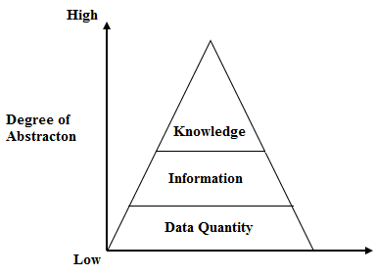
The above figure shows abstraction of data quantity, information and knowledge.
Knowledge base system -It is a form of artificial intelligence that aims to capture the knowledge of human experts to support decision-making. These systems depend on a rich base of knowledge to perform difficult tasks.

Slide 7
Types of knowledge
Declarative knowledge- It requires a Program to know what to do with knowledge and how to do it. Representation of facts and associations, static representation relations and states of objects, events etc.
Procedural knowledge- It control information necessary to use knowledge is embedded in the knowledge itself. It requires an interpreter to follow instructions specified in knowledge. Representation of actions or consequences.

Slide 8
Knowledge Representation
Knowledge is the pinnacle of any artificial intelligence Problem. Let us consider, what kind of knowledge might need to be represented in artificial intelligence systems-
Objects – facts about objects in our world domain. Example-guitars have strings, Trumpets are brass instruments.
Events- Actions that occur in our world. Example- Steve Vai played the guitar.
Performance- A Behavior like playing guitar involves knowledge about how to do things.
Meta-Knowledge – Knowledge about what we know.

Slide 9
In problem solving in Artificial Intelligence, we must deal with two entities-
Facts- Truths about real world. These are the things we want to represent.
Representation of Facts- Representation of facts, in a chosen formalism.
We can structure these entities at two levels-
The Knowledge Level- At which facts are described.
The Symbol Level- At which representation of objects are defined in terms of symbols that can be manipulated in Programs.

Slide 10
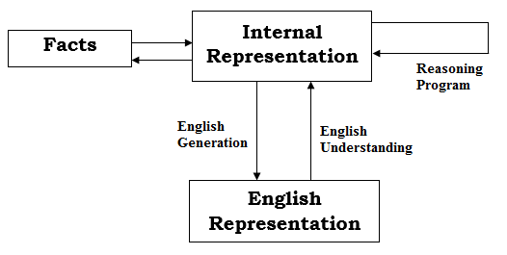
The above figure shows Mapping between facts and representation
English or Natural Language is an obvious way of representing and handling facts.

Slide 11
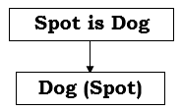
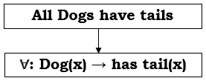
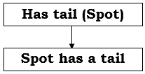
Example- Let us consider a simple mathematical logic as representational formalism.
Then using deductive mechanism of logic, we may generate-

Slide 12
Properties of Knowledge Representation System-
The following properties should be possessed by a Knowledge Representation system-
Representational Adequacy- The ability to represent all of the kinds of knowledge that are needed in that domain.
Inferential Adequacy- The ability to manipulate the knowledge represented to produce new knowledge corresponding to that inferred from the original.
Inferential Efficiency- The ability to direct the inferential mechanisms into the most productive directions by storing appropriate guides.
Acquisitional Efficiency- The ability to acquire new knowledge using automatic methods wherever possible rather that reliance on human interventions.

Slide 13
Approaches of Knowledge Representation-
Simple Relational Knowledge-The Simplest way of storing facts is to use relational method where each fact about a set of object is set out systematically in column. This representation gives little opportunity for inference, but it can be used as the knowledge basis for inference engines.
Example-
Musician | Style | Instrument
A | JAZZ | Trumpet
B | ROCK | Guitars
C | ROCK | Trumpet
D | JAZZ | Guitars

Slide 14
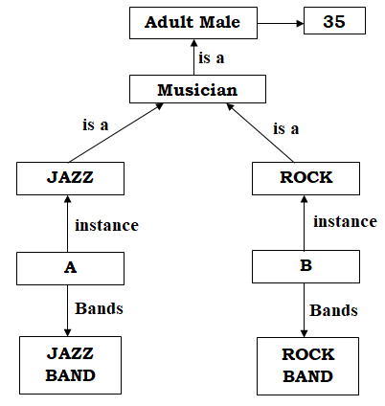
Inheritable Knowledge-Knowledge in which elements of specific class inherits attributes and values from more general classes in which they are included. In this object must be organized into classes and classes must be organized into generalization hierarchy.
Example-

Slide 15
Inferential Knowledge- In this type of Knowledge is represented as formal logic:
∀: Dog(x) → has tail(x) all dogs have tails.
Advantages-
It can be used to derive more facts.
Truths of the new statements can be verified.
It provides guaranteed correctness.
It is very popular in Artificial Intelligence.
Example- Automatic Theorem Proving

Slide 16
Procedural Knowledge- Procedural Knowledge involves knowing how to do something. Knowledge encoded in procedures are basically small programs that know how to do specific thing or task and how to proceed.

Slide 17
Logical representation-
Propositional Logic- A Propositional logic is a sentence written in a language that has a truth value. Propositions can be built from simple propositions using logical connectives. A Preposition is either
An Atomic Proposition, or
A Compound Proposition
­­­­­¬P | Negation of P
P ^ Q | Conjunction of P and Q
P ˅Q | Disjunction of P and Q
P →Q | P implies Q
P →Q | Q implies P
P ↔Q | P if and only if Q

Slide 18
Example-
It is hot => A
It is humid => B
It is raining => C
If it is humid, then it is hot => B→A
If it is hot & humid, then it is not raining => (A^B) → ¬ C

Slide 19
First Order Predicate Logic- A Predicate is a verb phase template that describes a property of objects, or a relationship among objects represented by the variables.
Example-
Last two examples does not fully justify the sentence so, here we use quantifiers. There are two types of quantifiers-
Universal Quantifier- ∀ x => For ALL
Existential Quantifier- ∃x => For SOME
Gorilla is Black => Gorilla(x) => Black(x)
John is tall => John(tall)
All Boys like Cricket => Like(Boys, Cricket)
Some Boys like Cricket => Like(Boys, Cricket)

Slide 20
Example-
All Boys like Cricket => ∀x: Boys(x) → like(x,Cricket)
Some Boys like Cricket => ∃x: Boys(x) → like(x,Cricket)
All Kings are person => ∀x: King(x) → person(x)
All Romans were either loyal to Caesar or hated him => ∀x: Roman(x) → loyal to(x,Caesar) ˅ hate (x,Caesar)

Slide 21
Now suppose we want to use these statements to answer a question-
Was Marcus loyal to Caesar?
Marcus was a Man => Man(Marcus)
Marcus was a Pompeian => Pompeian(Marcus)
All Pompeians were Romans => ∀x: Pompeians(x) → Roman(x)
Caesar was a ruler => ruler(Caesar)
Marcus try to assassinate Caesar => try to assassinate(Marcus,Caesar)
All Romans were either loyal to Caesar or hated him =>
∀x: Roman(x) → loyal to(x,Caesar) ˅ hate (x,Caesar)

Slide 22
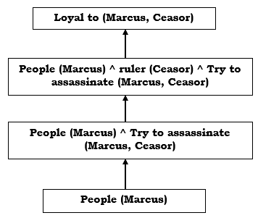
From statement 1-6 we can prove

Slide 23
Difference between Propositional Logic and FOPL-
 | Propositional Logic | First Order Predicate Logic
1 | It uses Preposition in which complete sentence is denoted by symbol | FOPL uses predicate which involves constants, Variables functions, relations etc.
2 | Prepositional Logic cannot represent individual entities. E.g. Meera is Short | FOL can represent individual entities. E.g. Short (Meera)
3 | It cannot express generalization, specialization or Pattern. | It can express generalization, specialization or Pattern.

Slide 24
Situation calculus-
The Situation Calculus is a logical Language for representing changes. The basic concepts in the situation calculus are Situations, Actions and Fluents.
Actions are what make the dynamic world change from one situation from another when performed by agents.
Fluents are situation-dependent functions used to describe the effect of action. There are two types of fluents-
Relational Fluent have only two values: True or False
Functional Fluent take a range of values.

Slide 25
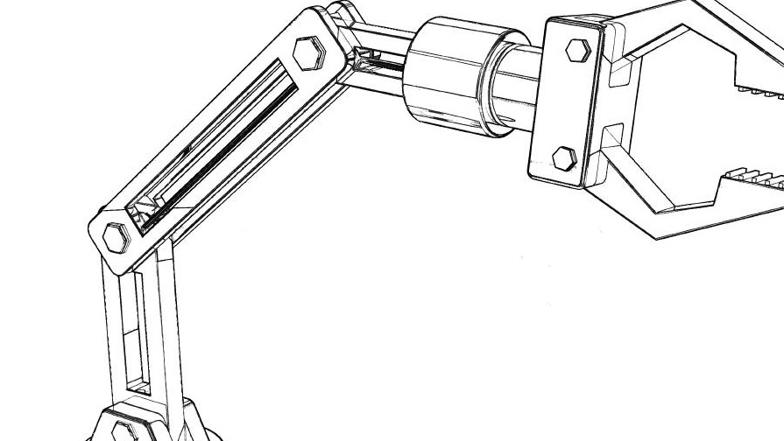
Example- One may have a relational fluent called “handempty” which is true in a situation if the robot’s hand is not holding anything. One may have a functional fluent called “Battery-level” where value is a situation is an integer between 0 and 100 devoting the total battery power remaining on one’s laptop or mobile.

Slide 26
To describe a dynamic domain in the situation calculus, one must decide on the set of actions available for the agents to perform, and the set of fluents needed to describe the changes these action will have on the world.
Example- Consider the classical Block-World problem where some blocks of equal size can be arranged into a set of towers on a table. The set of actions in this domain depends on what the imaginary agent can do. If we imagine the agents to be a one-handed robot that can directed to grasp any block that is on the top of another tower or put it down on the table to make a new tower, then we have the following actions:-

Slide 27
Stack(x, y) - Put block x on block y. Provide the robot is holding x and y is clear i.e., there is no other block on it.
Unstack(x, y) - Pick up block x from block y. Provided the robot’s hand is empty, x is on y and x is clear.
Putdown(x) - Put block x down on table. Provide the robot is holding x.
Pickup(x) - Pick up block x from table. Provided the robot’s hand is empty, x is on the table and clear.

Slide 28
To describe the effects of these actions, we can use the following relational fluents-
handempty - True in a situation if the robot’s hand is empty.
holding(x) - True in a situation if the robot’s hand is holding block x.
on(x,y) - True in a situation if block x is on block y.
clear(x) - True in a situation if block x is the top block of a tower i.e., the robot is not holding it, and there is no other block on it.
So for example, we can say that for action Stack(x,y) to be performed in a situation holding(x) and clear(y) must be true, and that after Stack(x, y) is performed. In the resulting new situation, on(x,y) and handempty , will be true, and clear(y) will no longer be true.

Slide 29
Theorem Proving in First Order Logic
Resolution- Resolution is a theorem proving technique that proceeds by building refutation proofs i.e., proofs by contradictions. It is used, if there are various statements are given and we need to prove a conclusion of those statements. Unification is a key concept in proofs by Resolution. Resolution is a single inference rule which can efficiently operate on the Conjunctive Normal Form (CNF) or Clausal Form.

Slide 30
Clause- Disjunction of literals (an atomic sentence) is called a clause. It is also known as a unit clause.
Conjunctive Normal Form (CNF) – A sentence represented as a conjunction of clauses is said to be Conjunctive Normal Form (CNF).
The Resolution Inference Rule- The resolution rule for First Order Logic is simply a lifted version of the Propositional Rule. Resolution can resolve two clauses if they contain complementary literals, which are assumed to be standardized apart so that they share no variables.

Slide 31
Steps of Resolution-
Negate the Statement to be proved.
Convert given facts into First Order Logic.
Convert First Order Logic into Conjunctive Normal Form.
Draw Resolution Graph.

Slide 32
Example-
Ravi likes all kind of food.
Apple and Chicken are food.
Anything anyone eats and is not killed is food.
Ajay eats Peanuts and still alive (not killed).
Rita eats that Ajay eats.
Prove- Ravi likes Peanuts

Slide 33
Step 1:- Ravi likes Peanuts => ¬likes (Ravi, Peanuts)
Step 2:-
∀x: food(x) → likes (Ravi,x)
food(Apple) food(Chicken)
∀x ∀y: eat(x,y) → ¬killed(x) → food(y)
eats(Ajay,Peanuts) ^ ¬killed(Ajay)
∀x: ¬killed(x) → alive(x)
∀x: alive(x) → ¬killed(x)
Step 3:- Eliminate → and ↔
a → b => ¬a˅ b
a ↔ b => a → b ^ b → a

Slide 34
Move ¬ inwards-
Rename Variables- Replace existential quantifier by skolem constant
∃x rich(x) → rich(g1)
Skolem Constant-It is a new constant that is substituted for a variable when eliminating an Existential Quantifier.
¬(∀xp) | ∃x ¬p
¬(∃xp) | ∀x ¬p
¬( a^b) | ¬a ^ ¬b
¬(a˅b) | ¬a ˅ ¬b
¬¬a | a

Slide 35
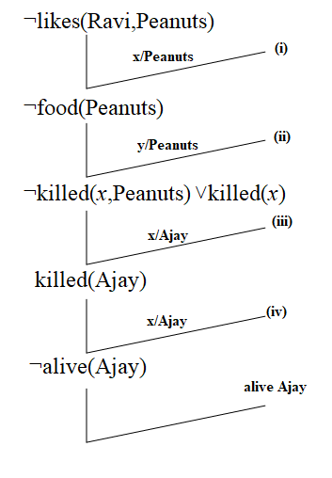
Drop universal Quantifier-
¬food(x) ˅ likes (Ravi,x)....................................(1)
¬[eats(x,y) ^ ¬killed(x)] ˅ food(y)
¬eats(x,y) ˅ killed(x) ˅ food(y)................. (2)
eats (Ajay,Peanuts)^ alive(Ajay)....................... (3)
¬killed(x) ˅ alive(x) ......................................... (4)
¬alive(x) ˅ killed(x) ......................................... (4)
Step 4:- Draw Resolution Graph-

Slide 36
Semantic networks-
A Semantic network or frame network is a network that represents semantic relation between concepts. This is often used as a form of knowledge representation. It is a directed or undirected graph consisting of vertices.
A semantic network is used when one has knowledge that is best understood as a set of concepts that are related to one another.
Disadvantages- Represents only Binary relations. E.g., Run (Chennai Express, Chennai, Bangalore, Today) cannot be asserted directly.

Slide 37
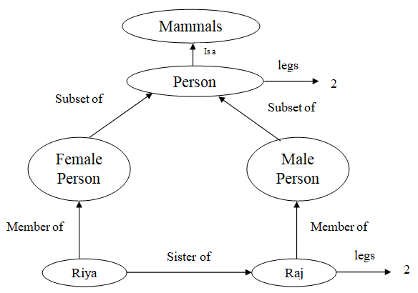

Slide 38
Planning
In order to solve most non-trivial problem, it is necessary to combine some of the problem-solving strategies.
The decomposition methods focuses on ways of decomposing the original problem into appropriate sub-parts and on ways of recording and handling interactions among the sub-parts as they are detected during the problem-solving process. The use of these methods is often called “Planning”.
The word Planning refers to “The process of computing several steps of a problem-solving procedure before executing any of them”.

Slide 39
The problem decomposition and its consequent change in the plan at local level has the following advantages in planning-
Reduce the complexity of Problem-Solving Process.
Reduce the complexity of the dynamic plan revision process.
The plan generation can proceed either in the forward direction or in the backward direction. In the forward going, branching factor is more than in the backward going.

Slide 40
The Problems associated with Planning-
It is overwhelmed by many irrelevant actions so, need a good heuristic functions.
Needs decomposing a problem into non-interactive components, as problem decomposing techniques contributes significantly to the efficiency of constraints under which the plan is bound to work.
There are various Planning Techniques-
Goal Stack Planning
Non-Linear Planning
Hierarchical Planning

Slide 41
Goal Stack Planning-
It is one of the earliest techniques to be developed for solving compound goals that may interact.
Goal stacks approach used by STRIPS (Stanford Research Institute Problem Solves) planner. The STRIPS representation is used to determine the values of primitive feature in a stack based on the previous state and the action taken by the agent.
In this method, the problem solver makes use of a single stack that contains both goals and operators that have been proposed to satisfy those goals.
The problem solver also relies on a database that describes the current situation and a set of operators described as PRECONDITION, ADD, and DELETE lists.

Slide 42
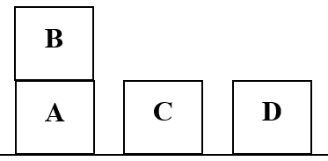
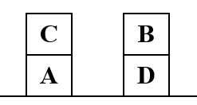
Let us consider an example-
Start: ON(B,A)^ ONTABLE(A)^ ONTABLE(D)^ ARMEMPTY | Goal: ON(C,A)^ ON(B,D)^ ONTABLE(A)^ ONTABLE(D)

Slide 43
When we begin solving this problem, the goal stack is simply.
ON(C,A)^ON(B,D)^ONTABLE(A)^ ONTABLE(D)
But we want to separate this problem, one for each component of the original goal, two of the sub-problems, ONTABLE(A) and ONTABLE(D) are already true in initial state.

Slide 44
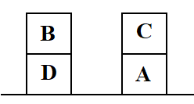
ON(C,A) ON(B,D)
ON(B,D) ON(C,A)
ON(C,A) ^ ON(B,D) ^ OTAD ON(C,A) ^ ON(B,D) ^ OTAD
[1] [2]

Slide 45
The important steps of the algorithm are-
Start by Pushing the original goal on the stack. Repeat this until the stack becomes empty. If stack top is a compound goal, then push its unsatisfied sub-goals on the stack.
If stack top is a single goal, then replace it by an action and push the action’s pre-conditions on the stack to satisfy the condition.
If stack top is an action, pop it from the stack, execute it and change the knowledge base by the effects of the action.
If stack top is a satisfied goal, pop it from the stack.

Slide 46
Since UNSTACK(B,A) is the first operator of the proposed solution sequence. At this point, the database corresponding to the world model is-
ONTABLE(A)^ONTABLE(C)^ ONTABLE(D)^ HOLDING(B)^ CLEAR(A)
The Goal Stack Now-
HOLDING(C)
CLEAR(A)^HOLDING(C)
STACK(C,A)
ON(B,D)
ON(C,A)^ON(B,D)^OTAD

Slide 47
Now we attempt to satisfy the goal HOLDING(C). There are two operators that might make HOLDING(C) true: PICKUP(C) and UNSTACK(C,x), where x could be any block from which C could be unstacked. We create two branches of the search tree, corresponding to the following goal stack-
ONTABLE(C) CLEAR(C) ARMEMPTY ONTABLE(C)^CLEAR(C)^ARMEMPTY PICKUP(C) CLEAR(A)^HOLDING(C) STACK(C,A) ON(B,D) ON(C,A)^ON(B,D)^OTAD [1] | ON(C,x) CLEAR(C) ARMEMPTY ON(C,x)^CLEAR(C)^ARMEMPTY UNSTACK(C,x) CLEAR(A)^HOLDING(C) STACK(C,A) ON(B,D) ON(C,A)^ON(B,D)^OTAD [2]

Slide 48
We opt alternative [2] because it contains a variable x, and any block could be substituted for x. So finally, the steps will be –
CLEAR(x)
HOLDING(C)
CLEAR(x)^HOLDING(C)
STACK(C,x)
CLEAR(C)
ARMEMPTY
ON(C,x)^CLEAR(C)^ARMEMPTY
UNSTACK(C,x)
CLEAR(A)^HOLDING(C)
STACK(C,A)
ON(B,D)
ON(C,A)^ON(B,D)^OTAD

Slide 49
After performing several steps the problem solver can return the plan-
UNSTACK(B,A)
STACK(B,D)
PICKUP(C)
STACK(C,A)

Slide 50
Hierarchical Planning-
In order to solve hard problems, a problem solver may have to generate long plans and in order to do that efficiently, it is important to be able to eliminate some of the details of the problem until a solution that addresses the main issues are found.
Hierarchical Planning was introduced or developed in ABSTRIPS system, which planned in hierarchy of abstraction spaces, in each of which precondition at a lower level of abstraction were ignored.

Slide 51
(OPERATOR
(PRECONDITION
(and(...)
(for all (w....)....)
(not
(exists...)
(or.......)))
(POSTCONDITION (ADD(...))
(DELETE(...))
(if (and(...)(...))
(ADD(...)(...))
(DELETE(...)(...))))))

Slide 52
The ABSTRIPS approach to problem-solving is as follows-
First solve the problem completely, considering only preconditions whose criticality value is the highest possible. These values reflect the expected difficulty of satisfying the preconditions. Preconditions having lower than the peak criticality are ignored.
Now use the constructed as the outline of a complete plan and consider precondition at the next lowest criticality level. Augment the plan with operators which satisfy those preconditions.
For choosing operators, ignore all preconditions whose criticality is less than the level we are considering currently. We continue this process of considering less and less critical preconditions until all of the preconditions of the original rules have been considered.

Slide 53
For a Hierarchical Planning system to work with STRIPS like rules, it must include the appropriate criticality value for each term which may occur in a precondition, in addition to the rules. By making use of this criticality value the hierarchical planning process becomes simple. This avoids wasting of efforts in filling in the details of plans which are not useful in solving the problem.

Slide 54
Non-Linear Planning –
Planning in ordered sequence cannot solve all the problems (e.g., Sussman Anomaly). A complete planner must allow for interleaving of actions from different sub plan within a single sequence (multiple sub-programs are worked simultaneously). Such plan is called Non-Linear Plan.
In other words,
Non-linear plan is a plan that is not composed of a linear sequence of complete sub plans.

Slide 55
A non-linear planner is a planner which when given two sub-goals G₁ and G₂ produces either a plan for G₁ concatenated with G₂ or vice versa.
Non-linear planning using constraint posting is a central technique.
Constraint Posting is “ A plan is prepared when there is no clear idea as how the operators should be ordered with respect to each other, they are only partially ordered to generate a partial plan.”

Slide 56
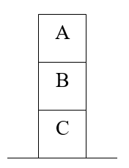
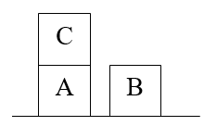
The reasons for using constraint postings are-
Difficult Problems causes goal interaction.
The operator used to solve one sub-problem may interfere with the solution to a previous sub-problem.
Most problems require an intertwined plan in which multiple sub-problems are worked on simultaneously.
Example- Sussman Anomaly
Start | Goal

Slide 57
The start state is given by-
ON(C,A) ^ ONTABLE(A) ^ ONTABLE(B) ^ ARMEMPTY
The goal state- ON(A,B) ^ ON(B,C)
This immediately leads to two approaches-
ON(A,B) ^ ON(B,C) ON(A,B)^ ON(B,C) | ON(B,C) ^ ON(A,B) ON(A,B) ^ ON(B,C)
[1] | [2]

Slide 58
Choosing approach [1] and trying to get block A on block B to the goal state.
ON(C,A)
CLEAR(C)
ARMEMPTY
ON(C,A) ^ CLEAR(C) ^ ARMEMPTY
UNSTACK(C,A)
ARMEMPTY
CLEAR(A) ^ ARMEMPTY
PICKUP(A)
CLEAR(B) ^ HOLDING(A)
STACK(A,B)
ON(B,C)
ON(A,B) ^ ON(B,C) goal state

Slide 59
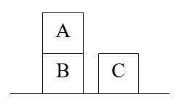
This achieves block A on block B which was produced by putting block C on the table. The sequence of Operators-
UNSTACK(C,A)
PUTDOWN(C )
PICKUP(A)
STACK(A,B)
Working on the next goal of ON(B,C) requires block B to be cleared so that it can be stacked on block C. unfortunately, we need to unstack A, thus the list of operations will become-

Slide 60
UNSTACK(C,A)
PUTDOWN(C )
PICKUP(A)
STACK(A,B)
UNSTACK(A,B)
PUTDOWN(A)
PICKUP(B)
STACK(B)
To get the state that block A is not on block B, two extra operations are needed-
PICKUP(A)
STACK(A,B)

Slide 61
Analysing this sequence, we observe that STACK(A,B) and UNSTACK(A,B) are opposite and therefore cancel each other out and PICKUP(A) and PUTDOWN(A) also cancel out each other. So, more efficient scheme is-
UNSTACK(C,A)
PUTDOWN(C )
PICKUP(B)
STACK(B,C)
PICKUP(A)
STACK(A,B)

Slide 62
Idea-Constraint Posting- The idea of constraint posting is to build-up a plan by incrementally hypothesizing operators, partial ordering between operators and building of variables within operators.
At any given time in the problem-solving process, we may have a set of useful operators but perhaps no clear idea of how these operators should be ordered with respect to each other.
A solution is a partially ordered, partially instantiated set of operator; to generate an actual plan, we convert the partial order into any of several total order.

Slide 63
Non-linear planning to solve the anomaly problem-
Step addition- Creating new steps for plan.
Promotion- Constraining one step to come before another in a final plan.
Declobbering- Placing one (possibly new) step S₂ between two old steps S₁ and S₃, such that S₂ reasserts some preconditions of S₃ that was neglected (or clobbered) by S₁.
Simple Establishment- Assigning a value to a variable, in order to ensure the preconditions of some step.
Separation- Preventing the assignment of certain values to a variable.

Slide 64
Constraint Posting plan ordering and variable binding constraints to build a concrete plan-
UNSTACK(C,A)
PUTDOWN(C )
PICKUP(B)
STACK(B,C)
PICKUP(A)
STACK(A,B)

Slide 65
Reasoning-
Reasoning is the mental process of deriving logical conclusion and making predictions from available knowledge, facts and beliefs.
“Reasoning is a way to infer facts from existing data”
In Artificial Intelligence, the reasoning is essential so that the machine can also think rationally as a human brain and can perform like human.

Slide 66

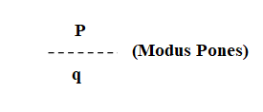
Types of Reasoning-
Deductive Reasoning- It uses rule and its precondition to make a conclusion. Example- If it rains, John carries Umbrella
This is just like if P then q

Slide 67
Modus Pones- The rule of logic which states that if a conditional statement (“if P then q”) is accepted, and antecedent (P) holds, then the consequent (q) may be inferred.
Modus Tollens- The rule of logic which states that if a conditional statement (“if P then q”) is accepted, and the consequent does not hold (not q) then the negation of the antecedent (not P) can be inferred.

Slide 68
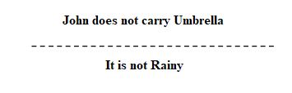
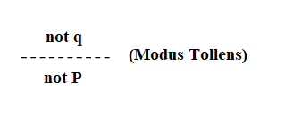
Example- If it is Rainy, John carries Umbrella
i.e., if P then q

Slide 69
Inductive Reasoning- It is learning the rule after numerous examples of conclusion following the precondition.
Example- #Good Movie
Fact: You have liked all movies starring Akshay
Inference: You will like his next Movie
Fact: He died, and she died, everyone died
Inference: I will die.

Slide 70
Abductive Reasoning- It means determine the precondition; it is using the conclusion and the rule to support that the precondition could explain the conclusion.
Example- Fact: A large amount of black smoke is coming from a house.
Abduction 1: The house is on fire
Abduction 2: Bad Cook
Common Sense Reasoning- It is an informal form of reasoning, which can be gained through experience. It relies on good judgement rather than exact logic and operator on heuristic knowledge and heuristic rules.
Example-
One Person can be at one place at a time.
If I put my hand in fire, then it will burn.

Slide 71
Monotonic and Non-monotonic Reasoning-
Monotonic Logic- The definite clause logic is monotonic in the sense that could be concluded before a clause is added, can still be concluded after it is added.
Non-Monotonic Logic- A logic is non-monotonic if some conclusions can be invalidated by adding more knowledge.
Example-
Monotonic- Once we get a conclusion, the addition of new facts will not change the conclusion i.e., Earth rotates around the Sun, adding new facts like “Saturn and Venus also revolves around Sun” will not affect our decision or conclusion.

Slide 72
Non-Monotonic- Suppose we want to buy a Cell Phone and our assumption is “The Cell Phone will be amazing (100%)”. Now we add more knowledge or facts-
It is a second-hand cell phone- now assumption percentage will be decreased (80%)
It was dropped Several times- now assumption percentage will be decreased (>50%)
Now if We apply the concept of Knowledge Base-
Birds Fly
Penguin Cannot Fly
Tweety is Bird
Now our Conclusion will be- “Tweety can Fly”.
But if we add more facts or Knowledge- “Tweety is a Penguin” then the decision will be “Tweety cannot Fly”. It will invalidate our first fact.

Slide 73
Probabilistic Reasoning-
Probability theory is used to discuss events, categories, and hypothesis about which there is not 100% certainty.
Example- What will be the Weather tomorrow?
We might formulate a remarkably simple hypothesis based on general observation, such that:- “It is sunny only 10% of the time and rainy 70% of the time”.
P(S)= 0.1 and P(R)= 0.7

Slide 74
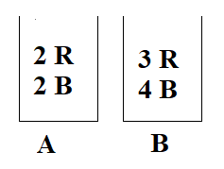
Bayes’ Theorem- Bayes’ theorem can be used to calculate the probability that a certain event will occur or that a certain proposition is true.
Example- Given that bag A is chosen, now calculate the probability of Red ball. P(R/A) = 2/4
Red ball drawn from bag A- P(A ∩ R) = P(A) P(R/A)
what is the probability of Red ball- P(R) = P(A ∩ R) + P(B ∩ R)
Given that Red ball is drawn. What is the probability that the ball is from bag A (Reverse Probability)-
P(A/R)= P(A ∩ R) / P(A ∩ R) + P(B ∩ R)

Slide 75

Problems associated with Bayes’ theorem-
If new information arises then all set of events must be recreated, and all possibilities recalculated.
Thus, simple bayes’ rule-based system are not suitable for uncertain reasoning.
Computation time is too large.
Updating new information is time consuming and too difficult.
Exceptions like “none of the above” cannot be represented.

Slide 76
Bayesian Network-
“A Bayesian Network is a probabilistic graphical model which represents a set of variables and their conditional dependencies using a directed acyclic graph”.
It is also known as Bayes’ Network, Belief Network, Decision Network, Casual Network and Probability Network.
It is a space efficient data structure, and it represents all of the directed casual relationship between variables. It can be reason for both Forward and Backward.

Slide 77
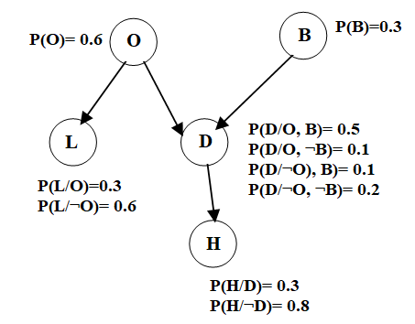
Example-
O:- Everyone is out of the house.
L:- The light is on
D:- The dog is outside
B:- The dog has bowl troubles.
H:- I can hear the dog barking

Slide 78
Knowledge Inference
Knowledge Inference reflects to acquiring new knowledge from existing facts based on certain rules and constraints. Inference engine is a tool of Artificial Intelligence, and it works in two modes-
Forward Chaining- Forward chaining starts with the available data and uses inference rules to extract more data. Example- Expert System, Business and Production rule systems.
Backward Chaining- It can be described as working backward from the goal. Example- Automated Theorem Provers, Inference Engines, Proof Assistants and Other Artificial Intelligence Applications.

Slide 79
Example- The law says that it is crime for an American to sell Weapons to hostile nations. The country Nono, an enemy of America, has some Missiles, and all of its Missiles were sold to it by Colonel West, who is an American. Prove that Colonel West is a criminal.
The law says that it is crime for an American to sell Weapons to hostile nations.=>
∀x: American(x)˄ Weapons(y)˄ hostile nations(z)˄Sell(x,y,z) → Criminal(x)
The Country Nono => Country(Nono)
An Enemy of America => Enemy(Nono, America)
Has Some Missile => ∃x: Missile(x)˄ Own(Nono,x)

Slide 80
And all of its Missiles were sold to it by Colonel West. =>
∀x:Missile(x)˄ Own(Nono,x) → Sell(West,x,Nono)
who is American => American(West)
Additional Background Knowledge-
Missiles are Weapon => ∀x: Missile(x) → Weapon(x)
Enemies of America are hostile => ∀x: Enemy(x,America) → Hostile(x)
Prove that – Col. West is a Criminal => Criminal(West)

Slide 81
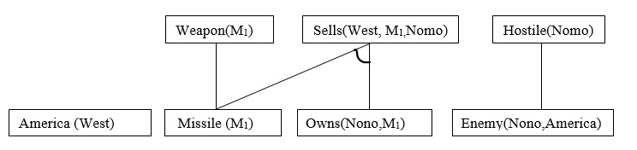
Forward Chaining-
Step 1:-
Step 2:-

Slide 82
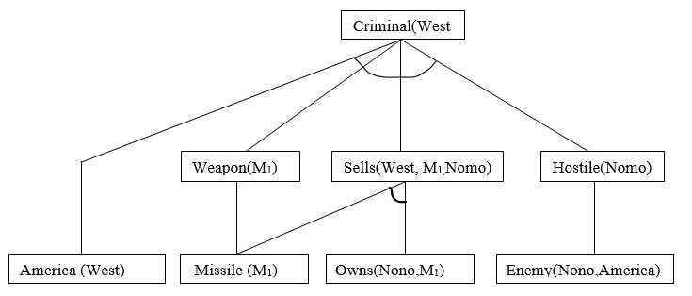
Step 3:-
Finally, from the given facts we proved that Colonel West is Criminal by using Forward Chaining Algorithm.

Slide 83

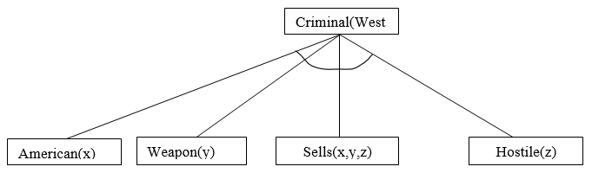
Backward chaining-
Step 1:-
Step 2:-

Slide 84
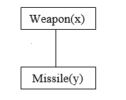
Step 3:-

Slide 85
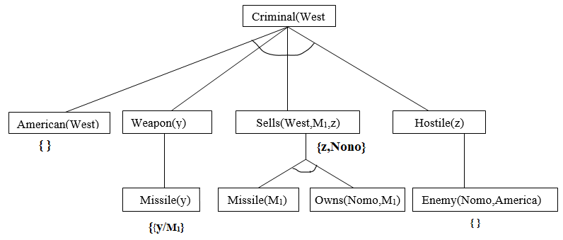
Step 4:-
Finally, from the facts we proved that Colonel West is Criminal by using Backward Chaining Algorithm.

